Slide 1
Detection of Ocular disease using Transfer and Federated Learning
Group No : 27
CSE 707
By
23366010 Bushra Rafia Chowdhury
23366028 Sadia Tasnim
23366032 Labib Hasan Khan
CSE 707 Course Instructor
Mr. Annajiat Alim Rasel
Senior Lecturer, Department of CSE
BRAC University
ST - Mehnaz Ara Fazal
RA - Md Sabbir Hossain

Slide 2
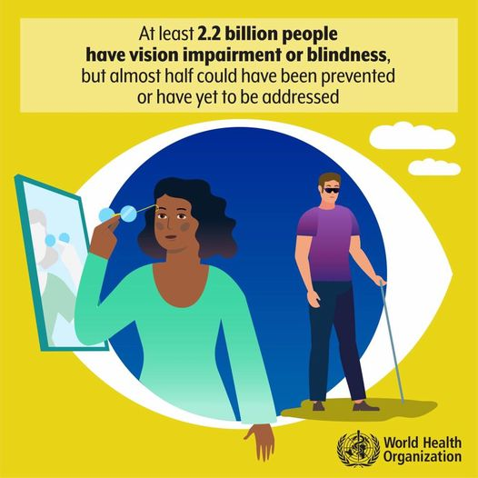
Introduction
Ocular diseases (e.g., glaucoma, diabetic retinopathy, macular degeneration)
Global impact on vision impairment and blindness
Importance of early detection and intervention
‹#›

Slide 3
Problem Statement
Rapid and automatic detection is essential.
Ophthalmologists face a substantial workload.
Automated methods may lack accuracy, requiring human validation.
Concerns about patient confidentiality and privacy.
Limited availability of diverse datasets for ocular diseases.

Slide 4
Literature Review 01 :
Introduces an approach based on deep learning for ocular disease diagnosis.
Utilizes advanced image categorization algorithms, including VGG-19, on the ODIR dataset with 5000 retinal images.
Dataset exhibits significant class imbalance, addressed by transforming the multiclass classification into a binary task.
VGG-19 training based on binary classifications yields high accuracy:
98.13% for normal vs. pathological myopia.
94.03% for normal vs. cataract cases.
90.94% for normal vs. glaucoma cases.

Slide 5
Literature Review 02 :
Proposes a deep learning-based system for reliable and cost-effective early diagnosis of ocular diseases.
Utilizes the ODIR dataset with annotations by trained human readers.
Model, leveraging computer vision and deep learning, demonstrates proficiency in detecting abnormalities from high-resolution fundus images.
Achieves peak accuracy of 93% for individual diseases and 83% for multiple diseases.

Slide 6
Literature Review 03 :
Introduces four deep learning-driven models for precise ocular tumor detection.
Employs cutting-edge image categorization algorithms (MobileNetV2, Resnet-34, VGG-16, EfficientNet) on the ODIR dataset with 5000 fundus images.
VGG-16 achieves 97.23% accuracy, Resnet-34 90.85%, MobileNetV2 94.32%, and EfficientNet 93.82% accuracy.
Models are positioned to contribute to the development of a system for prompt ocular disease diagnosis.

Slide 7
Literature Review 04 :
Introduction of an innovative multi-label CNN framework for identifying diverse ocular diseases in color fundus images.
Three main phases: preprocessing (normalization and augmentation), modeling, and prediction.
ML-CNN architecture with three convolution layers, max pooling layer, dropout, flatten layer, and fully connected layers.
Evaluation metrics: recall (80%), accuracy (94.3%), Dice similarity coefficient (99%), precision (91.5%), and AUC (96.7%).
Outperforms established models (SeResNext50, DenseNet201, MobileNetV2, InceptionV3, InceptionresNetv2).

Slide 8
Literature Review 05 :
Preprocessing with maximum entropy transformation.
CNN for feature extraction, optimized with a flower pollination optimization algorithm.
Optimization algorithm used for hyperparameter tuning during CNN training.
Output fed into a Multiclass Support Vector Machine classifier for disease categorization.
Evaluation on the Ocular Disease Intelligent Recognition dataset.
Superior performance in accuracy (95.27%), precision (98.30%), recall (93.3%), specificity (95.21%), and F1 score compared to other optimized models.

Slide 9
Overall Architecture
Dataset Augmentation
Manually encode labels
Train-validation-Test
Federated Average
Transfer Learning Architecture

Slide 10
Transfer Learning
EffecientNet V2
EffecientNet V1
MobileNet V2
Resnet50V2
Inception V3
VGGNet-16
VGGNet-19

Slide 11
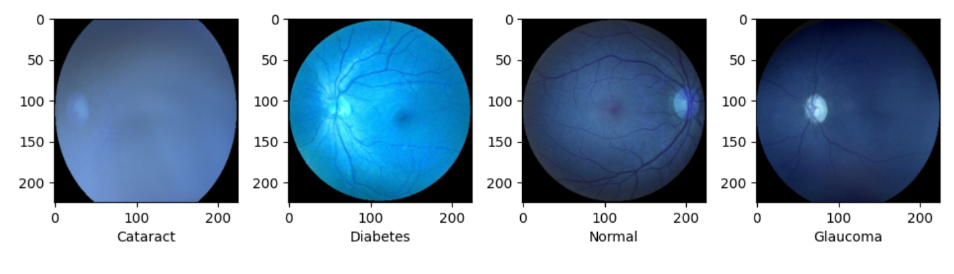
Collected Data
ODIR (Ocular Disease Intelligent Recognition) 2019
Approximately 5000 patients from China
Contains: Age , Color fundus photographs of both eyes & Diagnostic keywords from doctors.
Categories: normal (N), diabetes (D), cataract (C), glaucoma (G)

Slide 12
Label Description
Normal - Eye without any disease
Diabetes - Lack of ability to break sugar
Cataract - A cloudy area in the lens of your eye
Glaucoma - Optic nerve becomes damaged

Slide 13
Dataset Class Distribution
Type | Class Size | Encoded Label
Normal | 2873 | 0
Cataract | 293 | 1
Diabetes | 1608 | 2
Glaucoma | 284 | 3

Slide 14
Thank You

